Slide 1
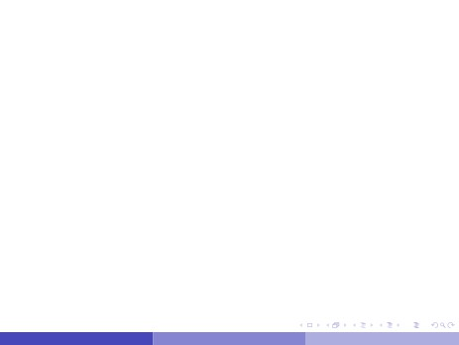
Measuring Radiation
Experiments with a Geiger-Müller Tube
N. Anna, A. Knight
University of Southern Maine Department of Physics
N. Anna, A. Knight
Measuring Radiation - Geiger-Müller Tube
March 21, 2016
1/13

Slide 2
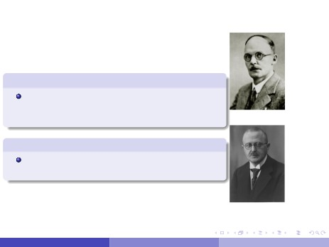
History Behind Measuring Radiation
Geiger
In 1908, Hans Geiger theorized that one
could detect radiation by the ionized particles
in its wake...
Hans Geiger
Müller
Walther Müller devised a cheap and reliable apparatus using Geiger’s theory...
Walther Müller
N. Anna, A. Knight
Measuring Radiation - Geiger-Müller Tube
March 21, 2016
2/13

Slide 3
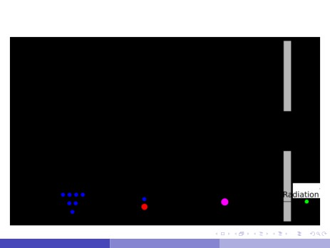
Geiger-Müller Tube
The basis for all Geiger Counters
N. Anna, A. Knight
Measuring Radiation - Geiger-Müller Tube
March 21, 2016
3/13

Slide 4
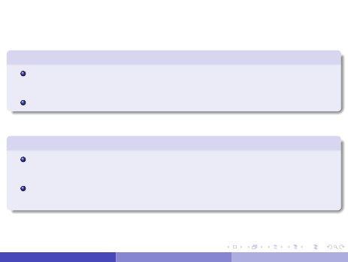
Relevant Information
Pros
In a sufficiently strong electric field, Townsend discharge effect ensures a count.
Cheap to manufacture and simple to operate.
Cons
Has a dead time after a each pulse, potentially missing ionizing radiation.
Cannot distinguish between radiation types, though this can be somewhat worked around by applying filters.
N. Anna, A. Knight
Measuring Radiation - Geiger-Müller Tube
March 21, 2016
4/13

Slide 5
Two Experiments:
Finding Ion Chamber Region Plateau &
Determining Mass Attenuation Coefficient
N. Anna, A. Knight
Measuring Radiation - Geiger-Müller Tube
March 21, 2016
5/13

Slide 6
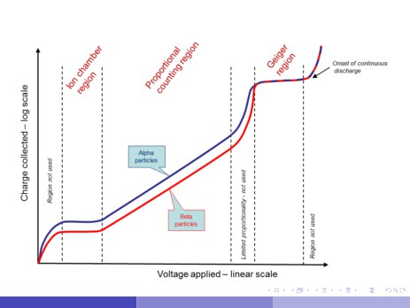
Detector regions
N. Anna, A. Knight
Measuring Radiation - Geiger-Müller Tube
March 21, 2016
6/13

Slide 7
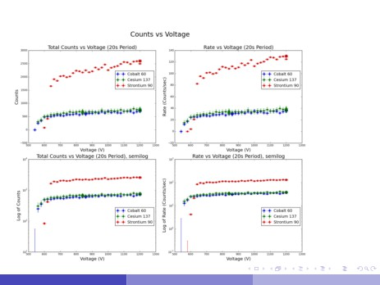
Our Data
N. Anna, A. Knight
Measuring Radiation - Geiger-Müller Tube
March 21, 2016
7/13

Slide 8
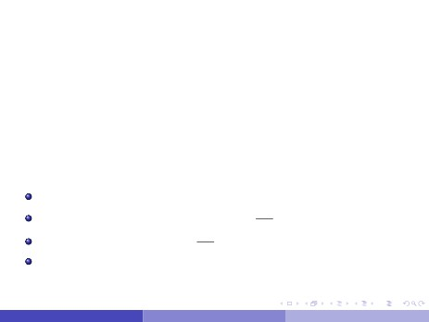
Theory in Absorption and Mass Attenuation Coefficient
Mass attenuation coefficient is a measure of how easily a material is pierced by a beam of particles, wave, energy or matter.
Follows the formula:
I(x ) = Io e−µρx
ln(I(x )) = −µρx + ln(Io )
Io: The intensity or counts with no absorption material. µ: Mass attenuation coefficient (incm2).
g
ρ: Density of material (ing cm3 ). x: Thickness of material.
N. Anna, A. Knight
Measuring Radiation - Geiger-Müller Tube
March 21, 2016
8/13

Slide 9
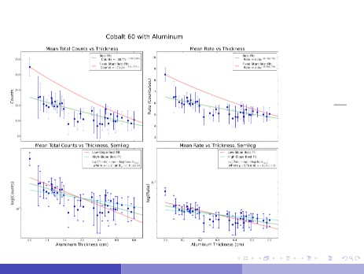
Results
Accepted Value:
µ = 0.055cm2
g
Our Value:
µ = 0.19±0.08
Error: 245.5%
N. Anna, A. Knight
Measuring Radiation - Geiger-Müller Tube
March 21, 2016
9/13

Slide 10
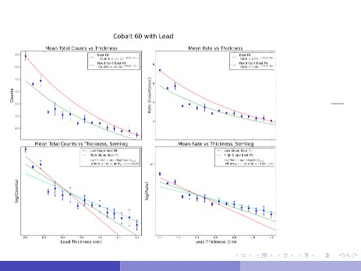
Results
Accepted Value:
µ = 0.059cm2
g
Our Value:
µ = 0.09±0.03
Error: 52.5%
N. Anna, A. Knight
Measuring Radiation - Geiger-Müller Tube
March 21, 2016
10 / 13

Slide 11
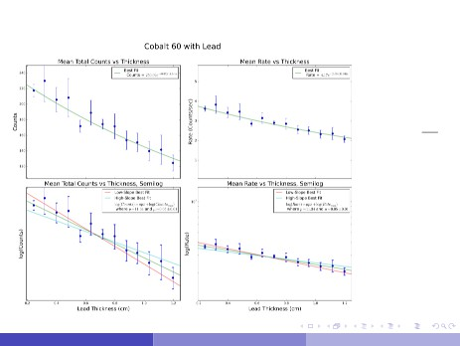
Results
Accepted Value:
µ = 0.059cm2
g
Our Value:
µ = 0.05±0.01
Error: 15.3%
N. Anna, A. Knight
Measuring Radiation - Geiger-Müller Tube
March 21, 2016
11 / 13

Slide 12
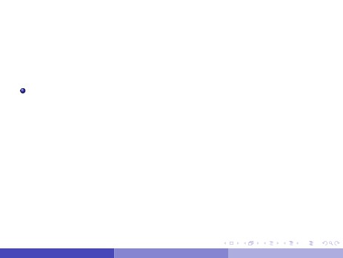
Uncertainties
Largest error source was variation in each data collection run.
To minimize, once can take more data over shorter intervals. One research project followed this method and used a Poisson distribution to determine the best value for each point.
There was some error during low voltages, as the potential difference was not enough to clean the ion build-up that diminished the internal electric field. This effect ceased when the voltage entered the ion chamber region.
N. Anna, A. Knight
Measuring Radiation - Geiger-Müller Tube
March 21, 2016
12 / 13

Slide 13
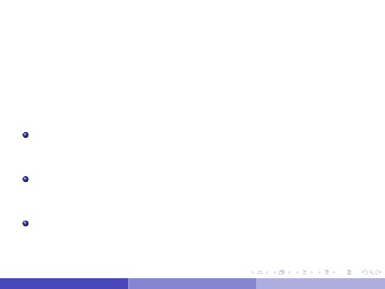
Conclusion
Overall, this was an experiment to understand and use a new
apparatus. We explored various types of experiments that can be done using this equipment, and found both positive and negative approaches. Our experiment produced either good data that was reasonably close to the expected value, or good insight into how to approach the experiment next time.
Some particulars:
A β radiation source would be a better to calculate the mass
attenuation coefficient for aluminum. γ radiation proved to be less than effective. Our strontium source would be sufficient for this. All radiation was emitted below 2MeV, which meant the only effect was ionization. From this, we did not have to consider the possibility of any other kind of radiation reactions in the tube. A computer program to take many data points automatically would drastically improve the uncertainty for this experiment. The limiting factor for us was simply time. Each run took from 20-60 seconds, which limited how many we could reasonably take.
N. Anna, A. Knight
Measuring Radiation - Geiger-Müller Tube
March 21, 2016
13 / 13

